Slide 1

Welcome to CPAN 212 Modern Web Technologies
My name is Harman

Slide 2

Agenda
Administration
Policies
Plagiarism
ChatGPT/AI
Introduction
Course Description
Rationale
Learning Outcome
Critical Path
Course Resources
Contact Information

Slide 3

Policies
Students must report an illness and absence prior to an exam or deadline. We now require doctor's note for proof of absence.
Always send an email about a situation before a due date if you cannot submit something
Don't send files/zips, those will not be looked at due to security concerns
Late submissions
for projects and assignments have a 5%-point deduction per day up to 5 days (maximum 25% deduction). After 5 days, no points will be given, however we can still check the work and give feedback.
For Labs and Tests
Do them before the deadline, there will be no major extensions.

Slide 4

Plagiarism
Definition:
Plagiarism is using someone else's ideas, words, or work without proper credit.
Types:
Copy Paste, Paraphrasing, Collusion
Consequences (It does scale):
You could be marked a 0
You could be removed from the school
How to avoid it
Cite source
Use tools if you need to help get things together

Slide 5

Chat GPT/AI
New technology – Schools haven’t completely moved into it yet -> its like saying google is bad
It’s a great TOOL when it's used for the right purpose
But don’t let yourself become the tool
Know what you are using it for and how it’s helping you
My belief is you don’t know how to do something, so showing examples are what's really going to help you, not “go do this” style learning.
Let's talk about it

Slide 6

Course Outline and Critical Path
Check Black Board for the PDF Files
Please note that the contents in the Critical Path can change as we progress through the semester
You want an easy semester?
You want a work heavy semester?
You want a collaborative semester?

Slide 7

Resources
"The Internet"
ChatGPT/AI tools
Google/Stack overflow/W3school
GitHub/YouTube
Herron, David (2020). Node.js Web Development, 5th ed. Packt Publishing
https://www.w3schools.com/nodejs
https://www.w3schools.com/react
https://expressjs.com/
Here is a YouTube tutorial for essentially 6 weeks of the course and more: Node.js and Express.js - Full Course (youtube.com)

Slide 8

Contact Information and Office hours
[Formal -> Unformal response]
You need to send something more formal:
Send me an email: Harman.Mann@humber.ca
Always send an email, it will have a timecode, so we know when I would be informed
You can wait for a response:
Send a message to me on Black Board
Something urgent:
Message me on teams
Response Rate: let's say within a few hours up to 2 days (48 hours), but I’ll see what I can do

Slide 9
What this course is all about
learn advanced and popular backend JavaScript framework, tools, and platform to create rich, powerful, modern web API (Application Programming Interfaces) and Microservices.
Using Node.JS and Express.JS and NoSQL database MongoDB.
Students also learn to develop the persistence layer to store, process and retrieve data and improve overall security with encryption, authentication, and authorization, configure and deploy the application

Slide 10
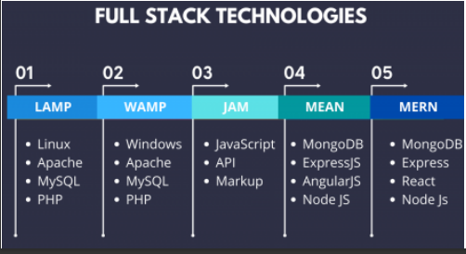
Fullstack
Fullstack development refers to someone who works on the front end and the backend based on the requirements for a project

Slide 11
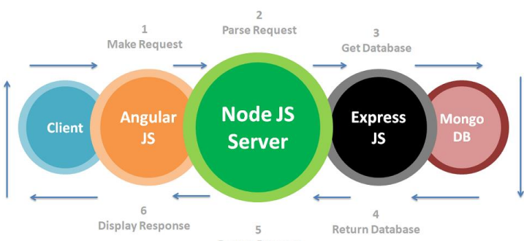
MERN Stack

Slide 12
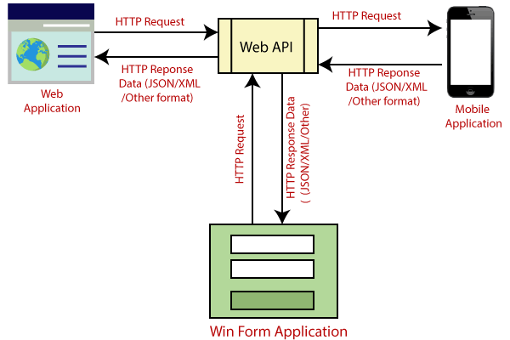
Web API Diagram
(2) Brief over Web API. | LinkedIn

Slide 13
Let me draw out the course as a diagram

